Slide 1
Workforce Housing Development
Watauga County, NC
Musa Practicum, Spring, 2024
Instructors: Michael Fichman & Matthew Harris
Team: Kathleen Scopis, Jingyi Cai, Yinan Li, Alice Han, Jarred Randall
Identifying Suitable Land Parcels for Workforce Housing Development
2024.04.30
Notes:
Topic: 2 sentence description (15 sec)
Note: may want to weave in challenges we faced with the data received and we collected (would help explain our progress)
Our client, the Watauga Housing Council of the Watauga County, wants a tool to help identify suitable parcels of land that are attractive to developers and to streamline their process in increasing their housing supply. Today, we will share our research and exploratory data analysis on this project.

Slide 2



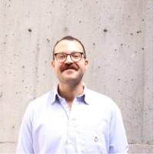

MEET THE TEAM
Jingyi Cai
Model Engineering Lead
MCP
Alice Han
JS Engineering
Lead
JD / MUSA
Yinan Li
Exploratory Analysis + Modeling Lead
MCP
Jarred Randall
Project Manager, Lead Researcher
MUSA
Kathleen Scopis
Project Manager,
Lead Writer
MCP
Introduction + Context
Use Case
Modeling
Application Development
Notes:
25 sec
Next, we want to introduce our team of five.
Name, project role.

Slide 3



CLIENT AND STAKEHOLDERS
AppHealth Care
Andy Blethen, Jason Pierce,
Luke Price
WATAUGA HOUSING COUNCIL
Dr. Kellie Reed Ashcraft, Dr. Chris Quattro, Laura Beach
Weitzman School of Design
Michael Fichman, Matthew Harris
Introduction + Context
Use Case
Modeling
Application Development
Notes:
18 sec
Before we start, we would like to thank our client and our stakeholders for sharing their time for us. We are glad to have the opportunity to apply our skills and contribute in a meaningful way to a real-world issue. We had multiple interviews with our main client, the Watauga Housing Council, and gleaned useful information from a stakeholder AppHealthCare, the district health department for Watauga. Lastly thanks to Professors Fichman and Harris for guiding us through.

Slide 4
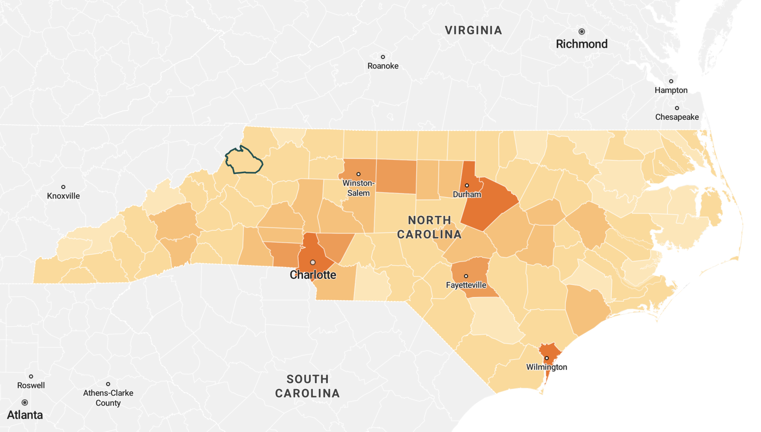
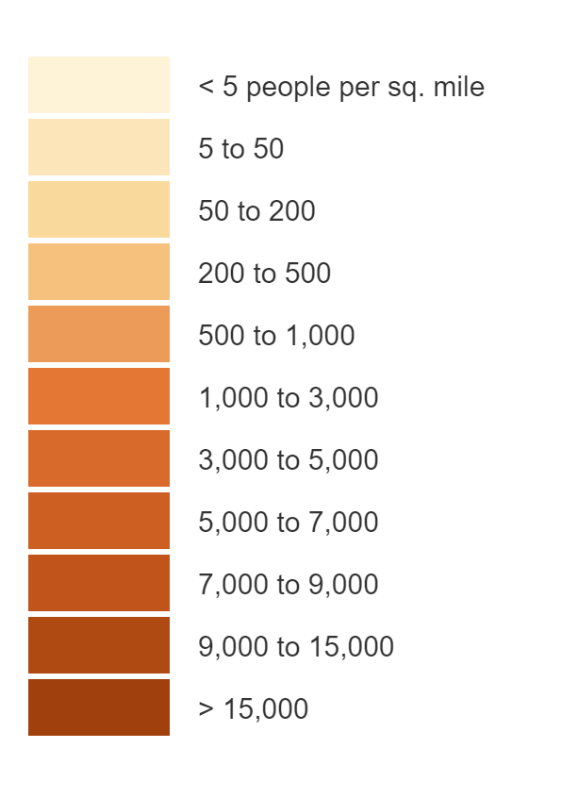
LOCATION AND CONTEXT
POPULATION DENSITY
Watauga
County
Source: Social Explorer Map
Introduction + Context
Use Case
Modeling
Application Development
Notes:
~10 sec
Watauga County is currently experiencing a housing shortage that is expected to intensify in the near future. The shortage is exacerbated by vacation rentals and student housing, which has significantly reduced the available residential housing options and increased the cost of living.

Slide 5
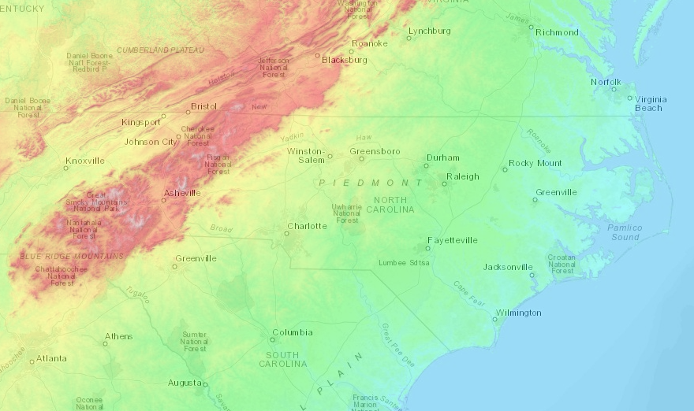
LOCATION AND CONTEXT
POPULATION DENSITY
Watauga
County
Source: Social Explorer Map
Introduction + Context
Use Case
Modeling
Application Development
Notes:
~10 sec
Watauga County is currently experiencing a housing shortage that is expected to intensify in the near future. The shortage is exacerbated by vacation rentals and student housing, which has significantly reduced the available residential housing options and increased the cost of living.

Slide 6

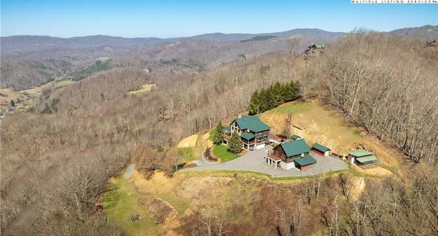
LOCATION AND CONTEXT
POPULATION DENSITY
Watauga
County
Source: Social Explorer Map
Introduction + Context
Use Case
Modeling
Application Development
Notes:
~10 sec
Watauga County is currently experiencing a housing shortage that is expected to intensify in the near future. The shortage is exacerbated by vacation rentals and student housing, which has significantly reduced the available residential housing options and increased the cost of living.

Slide 7



KEY STATISTICS
66%
College Student Housing
Vacation Housing
RENT BURDEN
Nationwide: 49.9%
* Rent burden = more than 30% of household income is spent on rent.
Soaring Rents & Home Values
$283,000
Decreasing Housing Affordability and Availability
Median House Value
Nationwide: $281,900
Introduction + Context
Use Case
Modeling
Application Development
Notes:
~10 sec
Watauga County is currently experiencing a housing shortage that is expected to intensify in the near future. The shortage is exacerbated by vacation rentals and student housing, which has significantly reduced the available residential housing options and increased the cost of living.

Slide 8


STRATEGIC ACTION
Strategic Actions
Watauga Housing Council Initiatives
Strategic Partnerships for Resource Integration: Forming partnerships with other community organizations and local government agencies.
Prioritization and Strategic Site Selection: working closely with developers to identify and prioritize the most feasible sites for the development of affordable housing.
Introduction + Context
Use Case
Modeling
Application Development
Notes:
Tasked with responding to the economic, environmental, and social aspects of the county to provide adequate housing options for all the residents of Watauga, the housing council is taking strategic actions to facilitate the development of more affordable housing in the county which include:
actively forming partnerships with other community organizations and local government agencies. This collaborative approach leverages a broader pool of resources, expertise, and legislative support to develop affordable housing projects more efficiently. These partnerships help integrate economic resources through shared funding and investments, ensuring that projects benefit from diverse inputs and sustain long-term viability.
and
Working closely with developers to identify and prioritize the most feasible sites for the development of affordable housing. This strategic site selection is crucial as it considers various factors like location, accessibility, environmental impact, and potential for community integration. By focusing on the most suitable locations, the Council ensures that the housing projects address both immediate and long-term needs of the community, providing resilient and strategically placed housing solutions.

Slide 9

PROBLEM STATEMENT
Site Selection Challenges: Because of the mountainous landscape’s Complex Terrain and the Extensive Inventory of over 47,000 parcels there is currently no streamlined system in place to help identify suitable parcels for development
Introduction + Context
Use Case
Modeling
Application Development
Notes:
~10 sec
Watauga County is currently experiencing a housing shortage that is expected to intensify in the near future. The shortage is exacerbated by vacation rentals and student housing, which has significantly reduced the available residential housing options and increased the cost of living.

Slide 10
PROBLEM STATEMENT
Addressing The Challenge: Create an Interactive Application that identifies Parcels Suitable for Affordable housing Development.
Notes:
~10 sec
Watauga County is currently experiencing a housing shortage that is expected to intensify in the near future. The shortage is exacerbated by vacation rentals and student housing, which has significantly reduced the available residential housing options and increased the cost of living.

Slide 11



QUANTIFYING DEVELOPMENT
Limited Wastewater Sewer Connections
Majority of the County is Rurally Located
Must Have a Septic System for Development
Introduction + Context
Use Case
Modeling
Application Development
Notes:
~10 sec
Watauga County is currently experiencing a housing shortage that is expected to intensify in the near future. The shortage is exacerbated by vacation rentals and student housing, which has significantly reduced the available residential housing options and increased the cost of living.

Slide 12
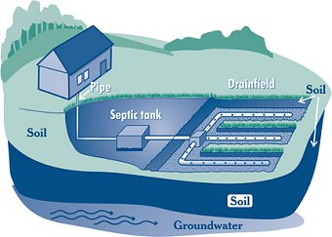
TARGET VARIABLE: SEPTIC PERMITS
SEPTIC SYSTEM PERMIT
DIFFERENCE WITH
SEWAGE SYSTEM
KEY PRECONDITION
FOR NEW DEVELOPMENT
Rural and extreme landscape means low wastewater sewer coverage
- Septic System: The waste goes into a holding tank on site.
- Sewer System: Sewers lines carry waste to a centralized treatment facility.
A parcel could not be developed without one septic system. Only Requirement for development.
Introduction + Context
Use Case
Modeling
Application Development

Slide 13
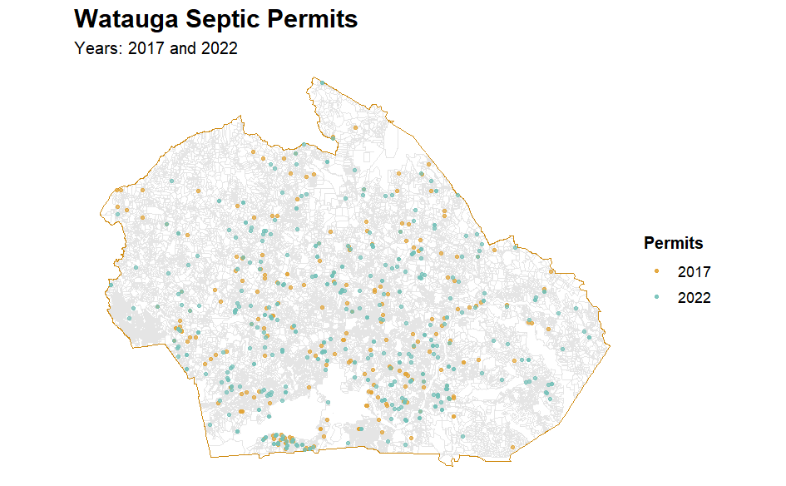
TARGET VARIABLE: SEPTIC PERMIT DATA
SEPTIC SYSTEM PERMITS
Years: 2017 and 2022
- Administrative record of new septic permits;
- Offered by The Appalachian District Health Department;
- #Permits - Year 2017: 300;
- #Permits - Year 2022: 472.
Introduction + Context
Use Case
Modeling
Application Development

Slide 14
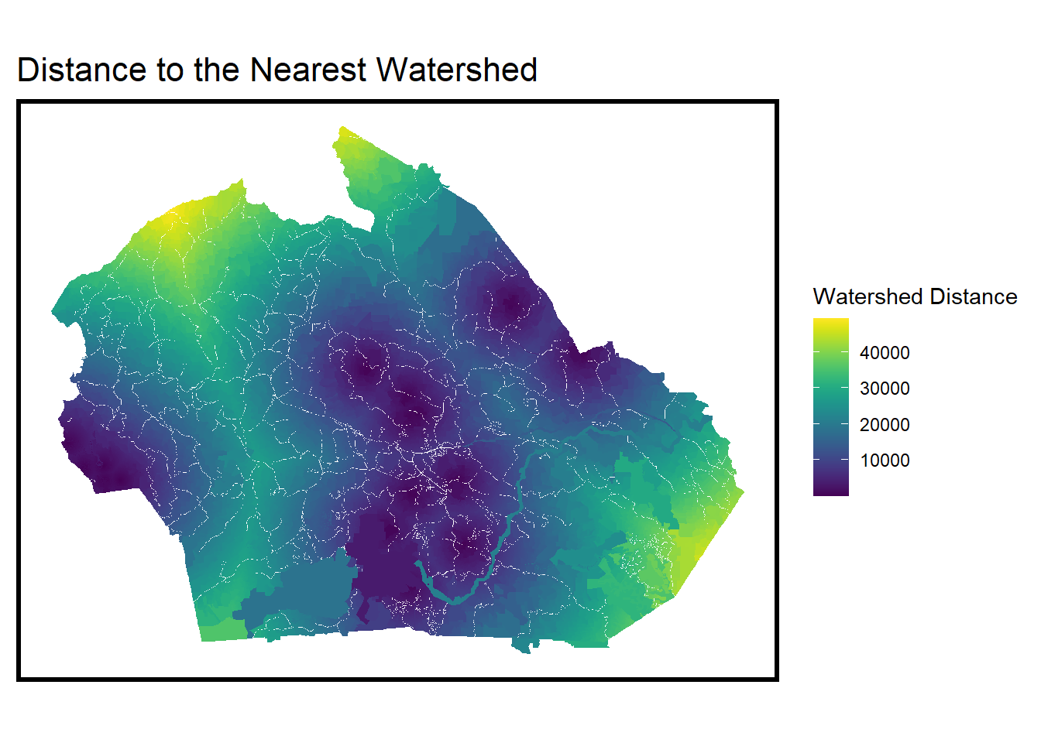
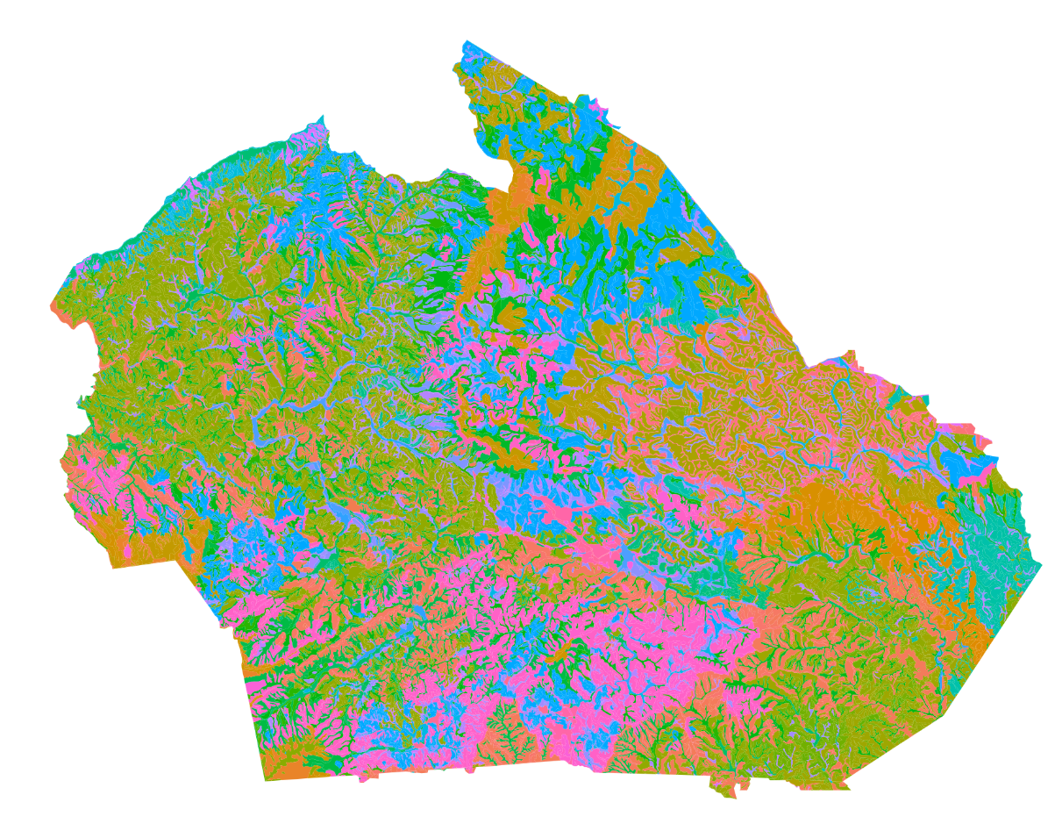
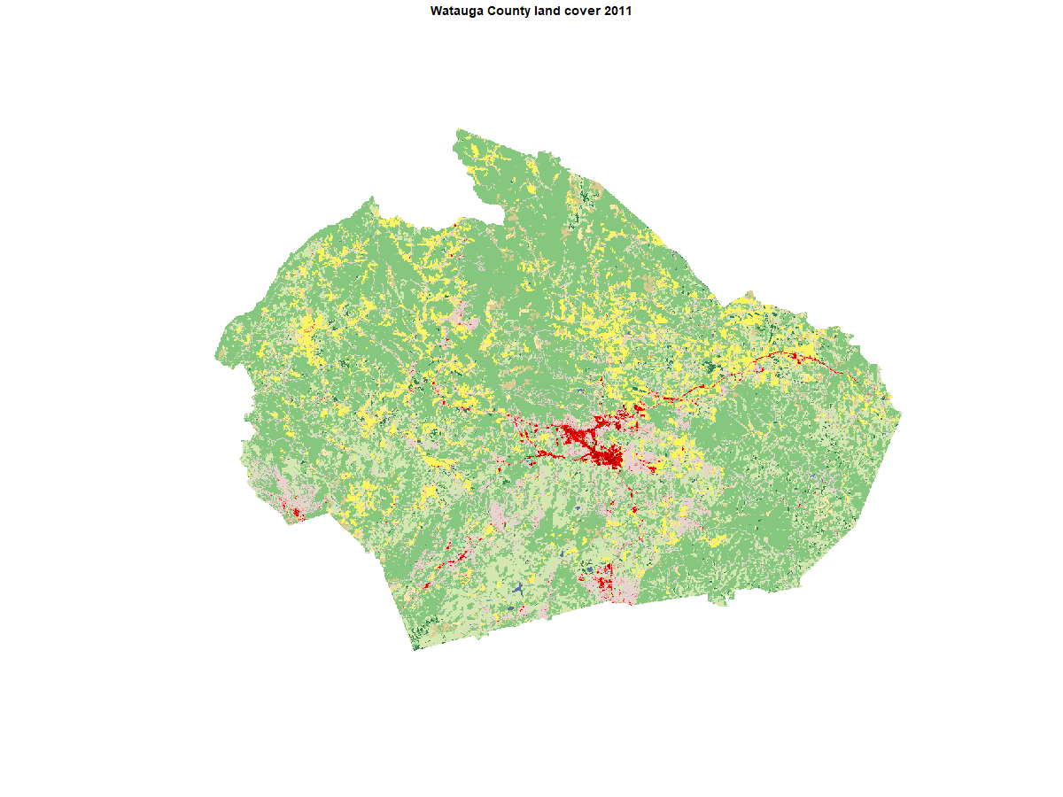
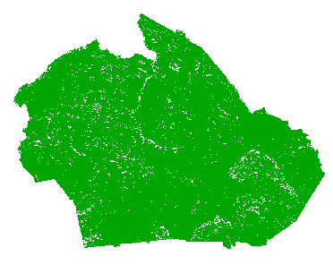
POSSIBLE PREDICTORS - TOPOGRAPHY
Distance to Waterbody
Land Cover (2011-2021)
Soil Type
Slope (<25° - Suitable）
Introduction + Context
Use Case
Modeling
Application Development

Slide 15
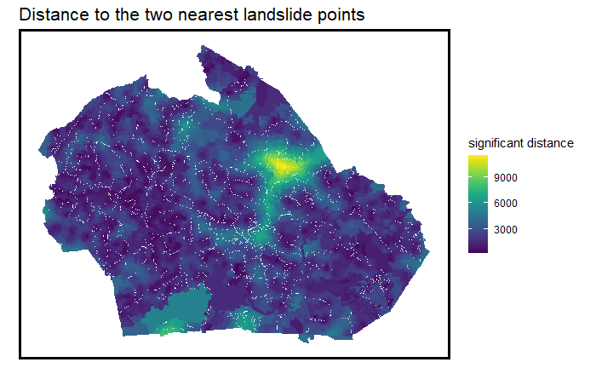
POSSIBLE PREDICTORS - DISTANCE
Distance to Landslide Point
Distance to Waterbody
Introduction + Context
Use Case
Modeling
Application Development

Slide 16
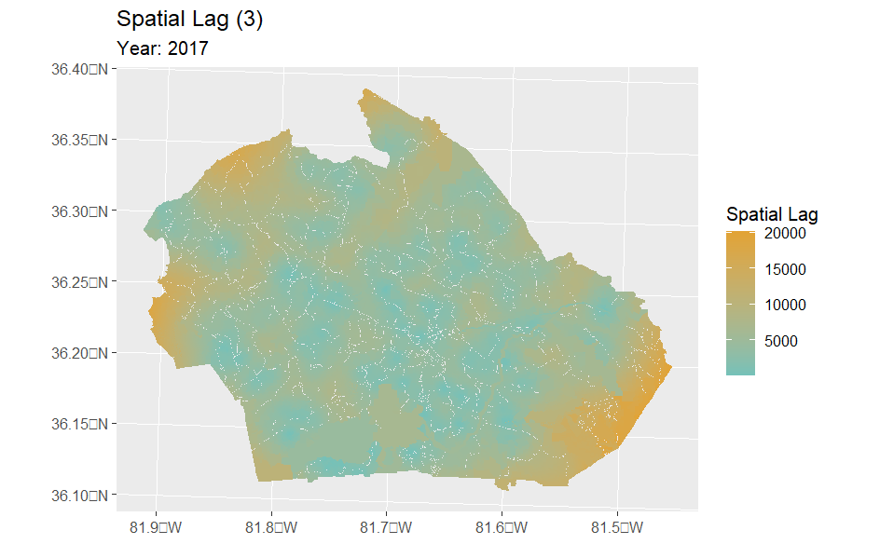
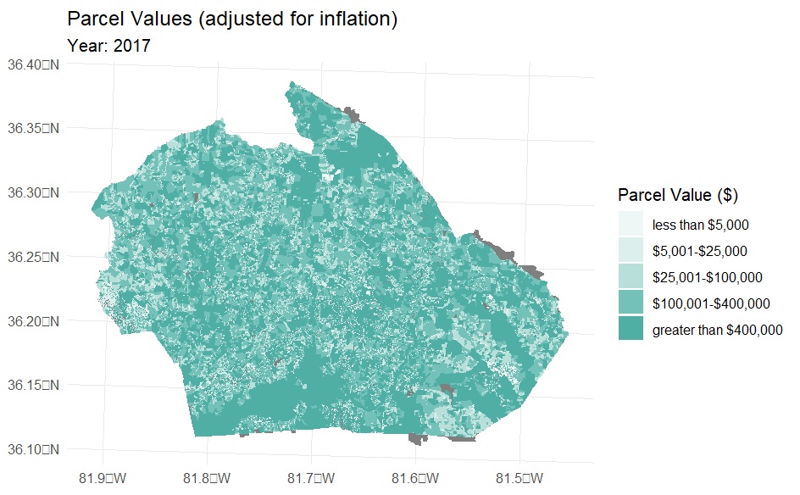
POSSIBLE PREDICTORS - OTHERS
Previous Septic Permits Spatial Lag (knn=3)
Introduction + Context
Use Case
Modeling
Application Development

Slide 17
MODELING

Slide 18


MODEL TRAINING
MODELING ROADMAP
FEATURES
TARGET VARIABLE
BINARY
Slope
Slope Min/Max/Avg
Resampled Dataset
We want to know the PROBABILITY of getting the permit
Land Cover
Land Type %
Soil Type
Soil Type %
Tuning
Waterbody
Waterbody Spatial Lag
Road
Road Spatial Lag
Predict
IMBALANCED DATA
Septic System Permits
Prediction
Natural Area
Natural Area?
Random Forest
“1”: 0.5%
with permit
Identify
“0” : 95.5%
without permit
Landslide
Landslide Spatial Lag
Inflation Adjusted Property Value
Suitable Land Parcels
BALANCED DATA
Property Value
Oversample Rare Event “1”
XGBoost
0.5% “1”
Oversample “1” to 10%
Previous Development
Previous Development Spatial Lag
Feature Engineering
Introduction + Context
Use Case
Modeling
Application Development
Notes:
Here is the roadmap for our research. After feature engineering, we started to build up our model. The target variable is septic system permits. The first challenge is the imbalance data. Only 0.5% of the parcels have new permits, which could hard to get a good model. So we firstly tried to oversample rare event “1” or try to use the poisson model. ~ 55s

Slide 19
MODELING ROADMAP
FEATURES
TARGET VARIABLE
MODEL TRAINING
Slope
Slope Min/Max/Avg
Resampled Dataset
Random Forest
Land Cover
Land Type %
Tuning
Soil Type
Soil Type %
Oversample Rare Event “1”
0.5% “1”
Waterbody
Waterbody Spatial Lag
Spatial CV
Road
Road Spatial Lag
Predict
Septic System Permits
Natural Area
Natural Area?
Identify
Landslide
Landslide Spatial Lag
Suitable Land Parcels
Probability Prediction
Property Value
Inflation Adjusted Property Value
XGBoost
Previous Development
Previous Development Spatial Lag
Feature Engineering
Introduction + Context
Use Case
Modeling
Application Development
Notes:
Here is the roadmap for our research. After feature engineering, we started to build up our model. The target variable is septic system permits. The first challenge is the imbalance data. Only 0.5% of the parcels have new permits, which could hard to get a good model. So we firstly tried to oversample rare event “1” or try to use the poisson model.

Slide 20
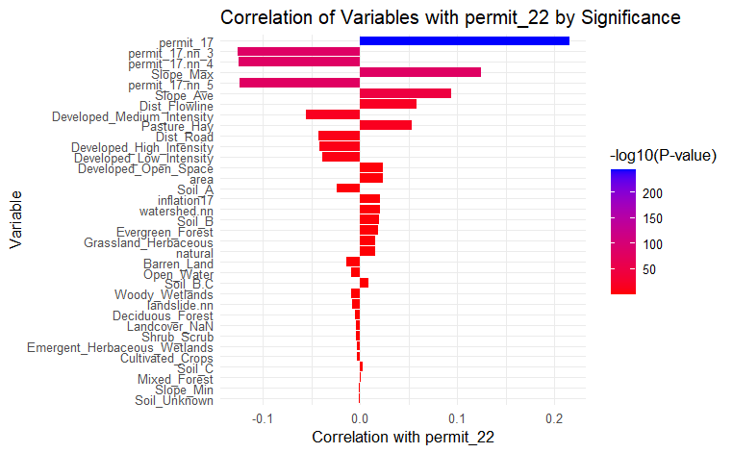
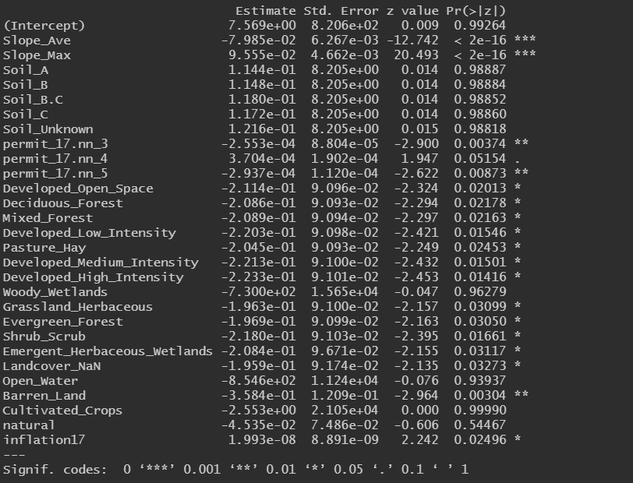



FEATURE SIGNIFICANCE
Spatial Lag
Slope
Flowline
Introduction + Context
Use Case
Modeling
Application Development

Slide 21
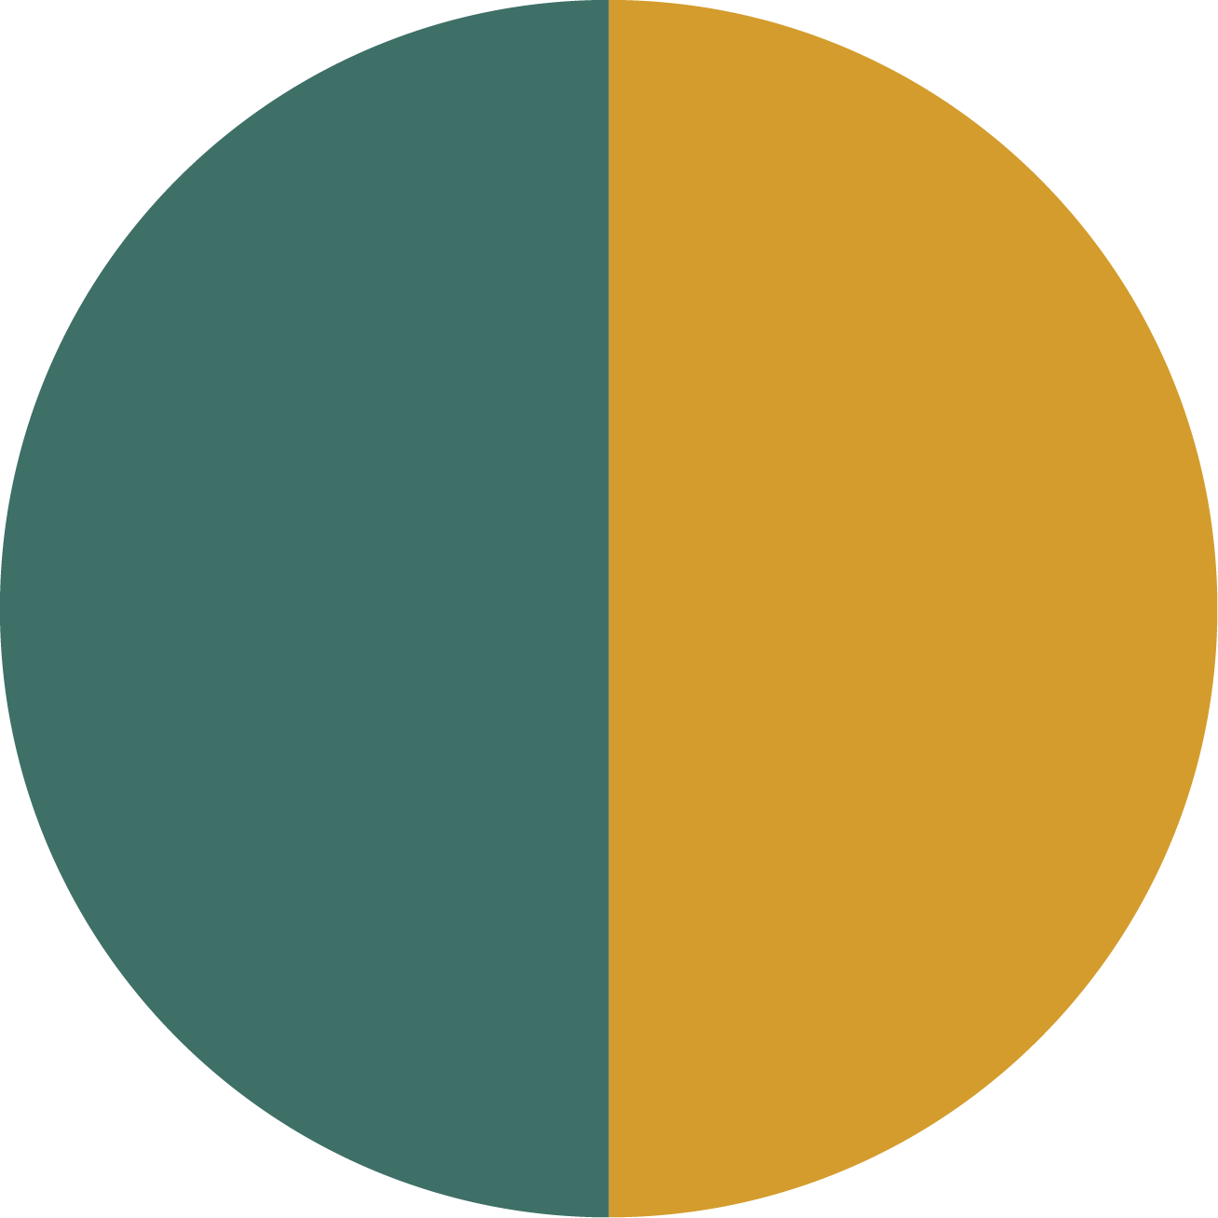
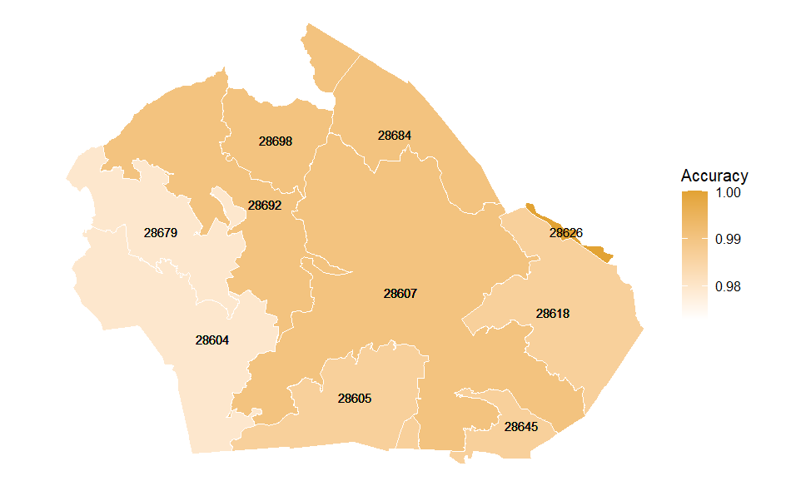

PERFORMANCE & SPATIAL CROSS VALIDATION
GENERALIZATION
ACCURACY
GENERALIZATION
The accuracy for each zip code
93.02%
True Positive
0.5
False Negative Rate
Correctly Predicted
permits
Permits “1”
93.02%
Accuracy
0.5
True Positive Rate
We want to know the PROBABILITY of getting the permit
Correctly predicted 93% permits
Correctly identified half of all the positive cases.
Model Performance by Zip Code
Introduction + Context
Use Case
Modeling
Application Development
ACCURACY

Slide 22
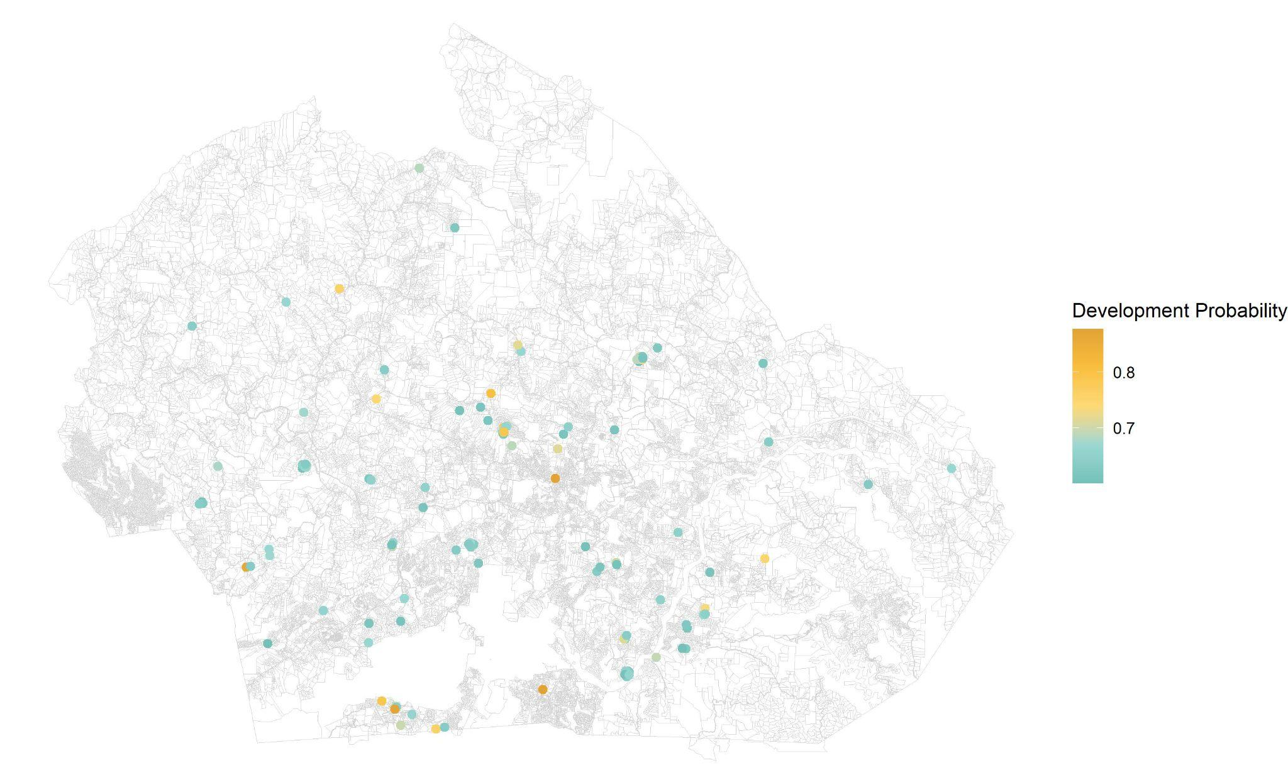
PREDICTION RESULTS
GENERALIZATION
Suitable Places for Development in 2027 (Prob>60%)
0.5
False Negative Rate
Boone
We want to know the PROBABILITY of getting the permit
Introduction + Context
Use Case
Modeling
Application Development
ACCURACY

Slide 23
APPLICATION DEVELOPMENT

Slide 24
USER’S WORKFLOW
STEP 1
Decide the workforce house type want to be developed.
STEP 2
Calculate the parcel size needed and number of septic system.
STEP 3
WATAUGA HOUSING COUNCIL
Filter out parcels meeting the requirement and rank them by suitability ranking.
STEP 4
“Use the app to identify the most suitable parcels before on-site evaluation.”
STEP 5
On-site evaluation.
Confirm the optimal parcel.
Introduction + Context
Use Case
Modeling
Application Development

Slide 25
APPLICATION LINK
https://seuha.github.io/watauga-app/

Slide 26
THANKS!
Does anyone have any questions?
Musa Practicum, Spring, 2024
Instructors: Michael Fichman & Matthew Harris
Team: Kathleen Scopis, Jingyi Cai, Yinan Li, Alice Han, Jarred Randall

